Slide 1

PCB Ballistic Stand project update
Anthony Molinaro
Caleb Gunter
Chris Jones
Stephan Jette

Slide 2
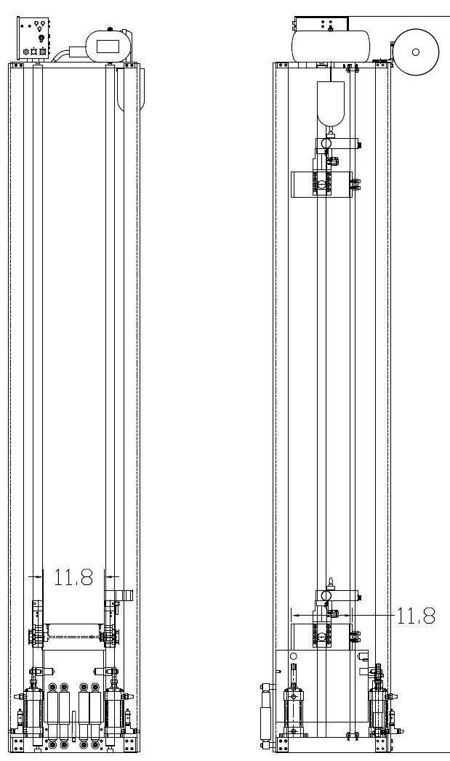
Updates
Originally planned to construct final product out of a 3D-printable material; this has since been changed to 6061 Aluminum to increase strength, durability, and reusability.
The stand profile has been refined into a cylindrical design to save weight/space. It has also been redesigned to function with or without acoustic dampening material, to enable acoustic detection of PCB fracturing.
The stand was originally intended to be mounted by a single large bolt to the drop tower, in order to reduce installation complexity and size. However, based on our calculations of stresses within the fastener, it was decided to revert to a safer, sturdier 4-bolt mounting configuration; potential maximum loading of a single bolt configuration exceeded the proof strengths of common bolts.
The cap will be fastened by 8x M6 bolts using time-serts.

Slide 3
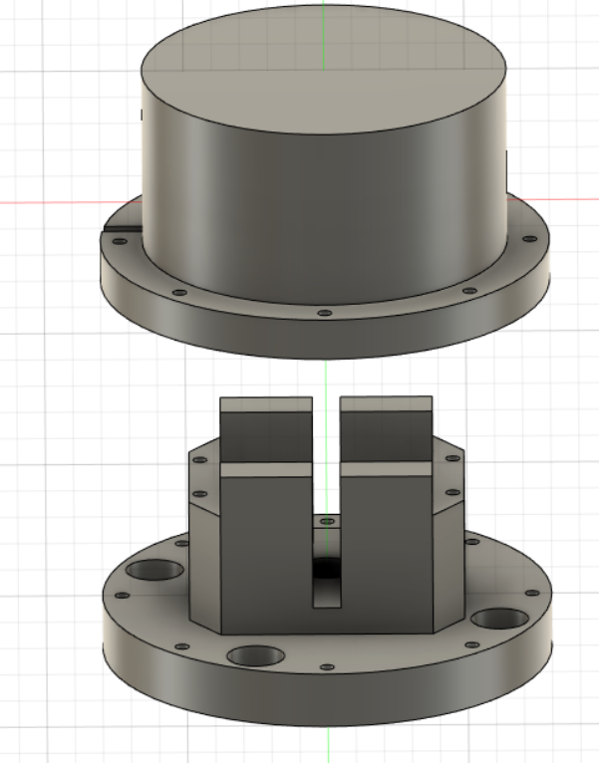
Core Design
Pictured is an assembly of the core components of the project.
The PCB board will be resting on the highlighted areas and restrained using clamp blocks.
The assembly can be used with or without the cap, as it is an optional component for acoustic isolation.
Remaining hurdles include fabrication, a final in-depth stress analysis and/or finite element analysis if necessary, and final approval of the overall design.
Once these tasks are complete, physical testing can begin.

Slide 4
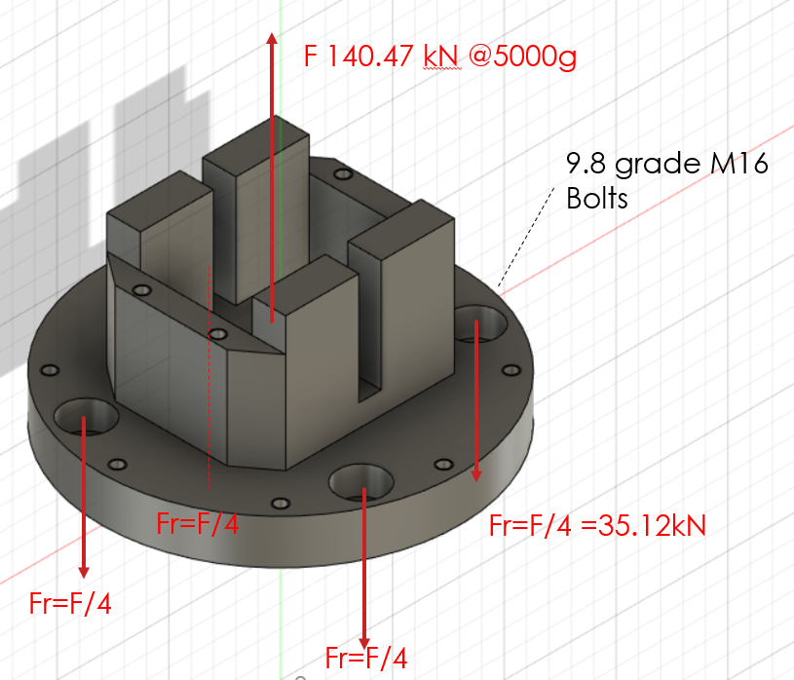
Updates
Analysis of reaction force after impact at 5000g
Reaction Force:
F=ma,
Where a=(9.81*5000) =49050 m/s^2
F=2.864kg*49050
F=140.47kN
Stress per Bolt:
σ=Fr/A,
where A =.000194m^2, per bolt (4x bolts) σ=140.47/(4*.000194)
σ=181.02 MPa
This is less than the proof strength of grade
9.8 M16 bolts by a factor of 3.5 (see next slide for reference.)

Slide 5
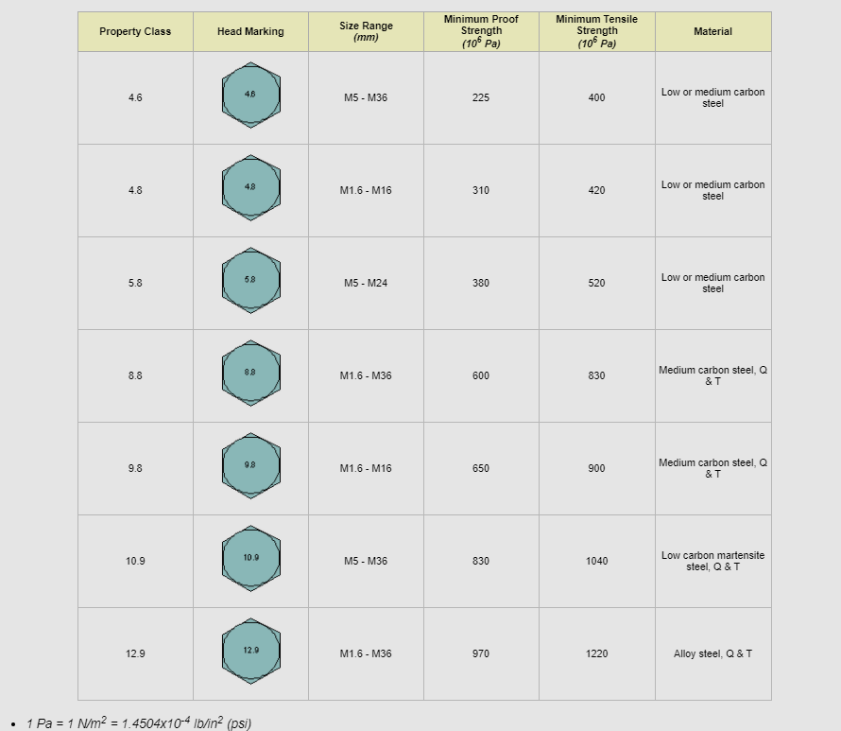
Updates
Pictured left, common strength ratings for metric bolts.
We intend on using M16 bolts with a Property Class of approximately 9.8. These bolts provide an excellent margin of safety, but heavier grades are available if preferred.

Slide 6
Thanks!
Name
Title
Email
Social

